Slide 1
Text Rendering with GDI
Programming – Introduction to C#
Last modified 12/12/16 by Alex Mackay

Slide 2
Contents
Preparing to render text
DrawString
A few examples

Slide 3
Preparing to Render Text
Rendering text in GDI is simple, all you need is:
A brush to render with
A font to use
Then you just call DrawString()
Notes:
Technically, Windows uses GDI+, and no longer supports the older GDI

Slide 4
Preparing to Render Text - Brush
Any type of brush will work
private void RenderTextExample(Graphics g)
{
//Brush to use to draw text with
System.Drawing.Drawing2D.LinearGradientBrush textBrush = new
System.Drawing.Drawing2D.LinearGradientBrush(ClientRectangle,
Color.Red, Color.Blue,
System.Drawing.Drawing2D.LinearGradientMode.Horizontal);
Notes:
Graphic objects for a form/control can be accessed either by:
1. Accessing the Graphics property of the PaintEventArgs passed into the Paint event of a form.
2. Call the CreateGraphics() function in any code run by a Control or Form to receive the Graphics object for that Control/Form
3. Graphics Objects can be gotten from a Image object, allowing you to render and change a pre-existing image.

Slide 5
DrawString
Once the Brush and Font are created, they need to be passed to DrawString()
g.DrawString("Text in GDI is easy!", font, textBrush, new
Point(10, 10));
Notes:
Graphic objects for a form/control can be accessed either by:
1. Accessing the Graphics property of the PaintEventArgs passed into the Paint event of a form.
2. Call the CreateGraphics() function in any code run by a Control or Form to receive the Graphics object for that Control/Form
3. Graphics Objects can be gotten from a Image object, allowing you to render and change a pre-existing image.

Slide 6
DrawString Examples - SolidBrush
private void RenderTextExample(Graphics g)
{
//Brush to use to draw text with
Brush textBrush = new SolidBrush(Color.Red);
// Font to render with
Font font = new Font("Times New Roman", 40);
g.DrawString("Text in GDI is easy!", font, textBrush,
new Point(10, 10));
textBrush.Dispose();
}

Slide 7
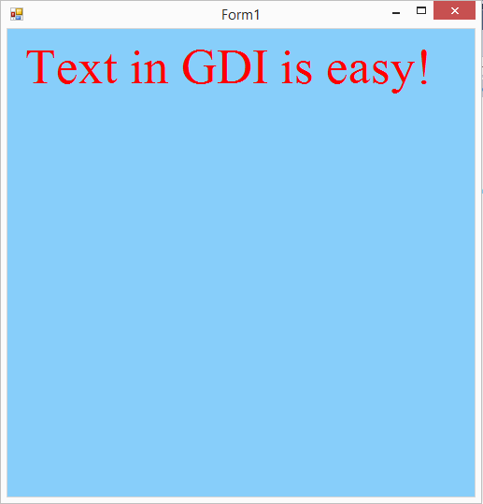
DrawString Examples - SolidBrush

Slide 8
DrawString Examples - LinearGradientBrush
private void RenderTextExample(Graphics g)
{
//Brush to use to draw text with
System.Drawing.Drawing2D.LinearGradientBrush textBrush = new
System.Drawing.Drawing2D.LinearGradientBrush(ClientRectangle,
Color.Red, Color.Blue, System.Drawing.Drawing2D.
LinearGradientMode.Horizontal);
// Font to render with
Font font = new Font("Times New Roman", 40);
g.DrawString("Text in GDI is easy!", font, textBrush, new Point(10, 10));
textBrush.Dispose();
}

Slide 9
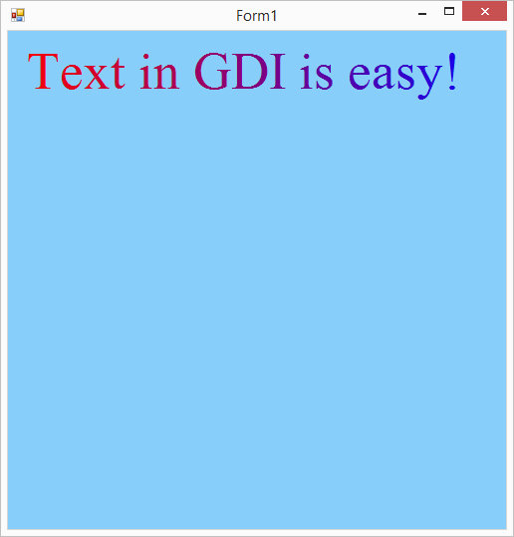
DrawString Examples - LinearGradientBrush

Slide 10
Summary
Text is easy
Create a Brush, create a Font
Call DrawString()

Slide 11
Further Reading
Microsoft, 2016, Drawing Text in GDI+, MSDN
https://msdn.microsoft.com/en-us/library/aa984365(v=vs.71).aspx

